Slide 1
Ethical Decision Making

Slide 2
A Framework for Ethical Decision Making
Recognize a moral issue
Get the facts
Evaluate the alternative actions from various moral perspectives (Ethical traditions)
  Which option will produce the most good and do the least harm?
  Which option respects the rights and dignity of all stakeholders?
  Will everyone still be treated fairly?
  Which option would promote the common good and help all participate more fully in the goods we share as a society, as a community, as a company, as a family?
  Which option would enable the deepening or development of those virtues or character traits that we value as individuals, as a profession, or as a society?
Make a decision
Act, then Reflect on the decision later
Notes:
Recognize a Moral Issue
Is there something wrong personally, interpersonally, or socially? Is there conflict that could be damaging to people? to animals or the environment? to institutions? to society?
Does the issue go deeper than legal or institutional concerns? What does it do to people as persons who have dignity, rights, and hopes for a better life together?
Get The Facts
What are the relevant facts of the case?
What individuals and groups have an important stake in the outcome? What is at stake for each? Do some have a greater stake because they have a special need (e.g., those who are poor or excluded) or because we have special obligations to them? Are there other important stakeholders in addition to those directly involved?
What are the options for acting? Have all the relevant persons and groups been consulted? If you showed your list of options to someone you respect, what would that person say?
Evaluate The Alternative Actions From Various Moral Perspectives
Which option will produce the most good and do the least harm?
Which option respects the rights and dignity of all stakeholders? Even if not everyone gets all they want, will everyone still be treated fairly?
Which option would promote the common good and help all participate more fully in the goods we share as a society, as a community, as a company, as a family?
Which option would enable the deepening or development of those virtues or character traits that we value as individuals? as a profession? as a society?
Make A Decision
[After taking into account the two questions below]
Considering these perspectives, which of the options is the right thing to do?
If you told someone you respect why you chose this option, what would that person say?
Act, Then Reflect On The Decision Later
How did it turn out for all concerned? If you had to do it over again, what, if anything, would you do differently?

Slide 3
Obligation Versus Outcomes
Teleological
  Focus on consequences, results, ends, goals, purposes of agents’ acts
  Focus on the agent or the results of the agents’ actions
Deontological
  Focus on the act
  Duties, rights, responsibilities, privileges pertaining to the act.
Notes:
Teleo: Agent oriented focus on agents moral responsibility, intentions, state on knowledge, virtues and self interests.
Results oriented focus on public interest, consequences for stakeholders.

Slide 4
Four fundamental focusing questions
Who is the agent?
What action(s) was actually taken or is being contemplated?
What are the results or consequence of the act?
Is the result fair or just?

Slide 5
Who is the agent?
Was the agent responsible for causing the issue to occur?
What are the motives, interests and character of the agent?
Use teleological (consequentialist) theories to assess agent’s position and clarify nature of the goals the agent is pursuing
Virtue ethics could also be used to determine the agent’s character

Slide 6
What action(s) was actually taken or is being contemplated?
Does the agent have a duty to perform the action?
Is the agent forbidden from performing it?
Does the agent have a right to perform the act?
Is the agent free?
Use deontological theories to determine the ‘rules’ or moral obligations. Assess how these have been followed or violated.

Slide 7
What are the results or consequence of the act?
Which stakeholders are affected and how?
Who are winners and losers?
Is the greatest good being done for the greatest number?
Use teleological (consequentialist) theories to weigh the outcomes as they affect stakeholders.

Slide 8
Is the result fair or just?
Are all parties being treated in a just and fair manner?
Are burdens and benefits being distributed fairly?
Are appropriate punishments being meted out to all wrongdoers?
Is adequate compensation being given to those wronged?
Use social contract/justice theories to answer these questions

Slide 9
Librarian's dilemma (Adapted from: Spinello R, "Cyber Ethics", ,Jones & Bartlett Publishers, 2000.)
As head of the library services in a medium sized town you have decided to provide internet access to library users. The installation of the hardware and software is an immediate success. The most popular activity is surfing the net. You are pleased because it allows those who cannot afford computers to gain internet access.
Problems soon begin to emerge. Your staff tell you that they have found two twelve-year-old boys downloading graphic sexual material. A few days later an older man is noticed looking at pornographic images. As time goes on there are similar incidents every few weeks.
Your associate librarian advises you to purchase and install some type of filtering software. Other colleagues remind you that this could violate your professional association's code of conduct. There is a reference in this to the fact that limiting access to library material by minors should not be a reason for diluting the library's collection. In fact one colleague argues that filtering is equivalent to buying an encyclopaedia and cutting out certain articles that do not meet certain standards. However, another colleague points out that the library does not put pornographic material on the shelves with other books and periodicals.
The local community leaders start pressurizing you to resolve the issue. What will you do? Do libraries have a moral right to protect children or limit access to material available to adults? What do ethical principles tell you about how to act?

Slide 10
Duties
Non-discretionary
  Treat everybody the same
  Speak the truth, keep promise
  May have exceptional circumstances
Discretionary
  Obligations not imposed
  Who we give charity to
Special
  Associated with career or profession
  Addition to other duties
Duties of Justice
  All unjust acts are wrong BUT not all wrong acts are unjust
  Concerned with what is just
  Respect for individual rights
    Legal rights - variable
    Moral rights - invariable, timeless, universal, equal
Duties of utility
  Potential conflict between outcomes and rights

Slide 11
Applying the model
Identify all major stakeholders
Identify values, goods and bads, rights and wrongs, just and unjust considerations to agents and stakeholders
Reflect on different ethical theories and principles – ‘what ought to be’ phase
Interpret facts in light of principles and theories…
May result in conflicting advice, so…
Use supersession
Notes:
Supersession means using one ethical principle to outrank another. The more ethical outcome tells us what decision to take. Justice is sometimes considered the highest order ethical principle

Slide 12
Agents
Focus on character and virtues of agents – moral responsibility
Agents must act knowingly and voluntarily for us to assign moral blame or praise
Voluntary action - easy to decide
  Knowingly and freely performed act - temptation
  Knowingly and freely failed to perform act – negligence
Involuntary action - more difficult to decide
  Ignorance - no responsibility
  Compulsion - no responsibility
  Due diligence - responsible if not applied
  Culpable ignorance -responsibility to keep up to date
  Wilful ignorance - hiding behind subordinates
Notes:
Agents act at different levels, as individuals, groups, organisations even entire societies.
Agents act in pursuit of own self interest (enlightened self interest also known as egoisim states this is a good think in the long run)
Assigning moral responsibility by focussing on agents or their actions? Deontology V Teleology?
Aristotle said agents must act knowingly and voluntarily if we are to assign moral praise or blame. 2 circumstances temptation or negligence
Involuntary action more difficult. Ignorance means no responsibility. Compulsion - if agent was forced to act then again no responsibility.
But…
Due diligence – not pursuing all course of action at agents’ disposal – e.g ignoring the fact some data may be corrupt
Culpable ignorance – responsibility of agent to acquire relevant information – e.g. not keeping up to date
Wilful ignorance – ensuring you don’t let others know what you know to avoid blame e.g bosses forcing staff to achieve goals using ‘any available means possible’

Slide 13
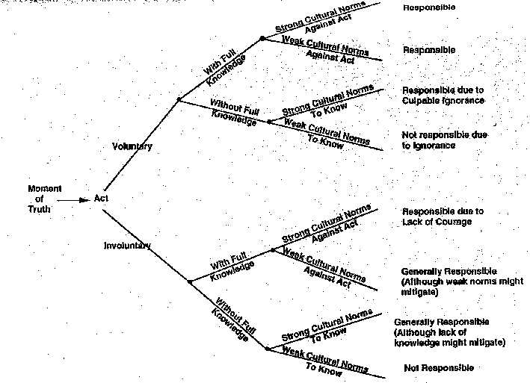
Notes:
Summary of responsibility of key agents
Voluntary Versus Involuntary behaviour
Behaviour taken with or without full knowledge
Cultural norms to practice due diligence and be fully informed

Slide 14
Actions
Agents take actions
What acts must, can or cannot be taken
Deontological reasoning
  Acts that must be taken - responsibilities or duties
  Acts that are permitted – privileges or rights
Duties and prohibitions
Notes:
Rights and duties are stronger moral guides (they are irrevocable) than responsibilities/duties (they may be revoked). Latter because of agents position, situation etc.
Some acts MUST be followed (duties) others are expressly forbidden.

Slide 15
Results of actions
Consequentialism and utilitarianism
Utilitarianism approach
  Identify alternative courses of action
  Estimate benefits of each alternative to each and every stakeholder
  Choose alternative with highest utility

Slide 16
Building a moral compass
What are the morally relevant facts of the case? In particular, who are the stakeholders? And what does each stakeholder have at stake?
Which (if any) concepts need to be clarified before we can make our best ethical judgment or decision? In particular, are there any evaluative or normative ideas that require thoughtful analysis?
Is anyone behaving in a virtuous manner? If so, who? How?
Is anyone behaving in a way that flouts the moral virtues? If so, who? How?
Are any non discretionary duties involved? If so, who has them?
Are any discretionary duties involved? If so, who has them?
Are any special duties involved? In particular, are there professional duties that are applicable? If so, who has them? To whom?

Slide 17
Building a moral compass 2
Are any duties of justice involved? If so, who has what rights? Against whom?
Are any duties of utility involved? If so, who will be affected? By whom? How much?
Do any of the duties involved conflict with one another? If so, which ones? How?
Has someone acted in supererogatory manner? If so, who? How?
Is someone being asked to act in a supererogatory manner? If so, who? By whom?
Taking all the relevant considerations into account, what do we
think should be done? What would be right? What, wrong?
What reasons can we give to support our answers to the previous question?

Slide 18
Building a moral compass 3
Bad consequences test
What would happen if everybody behaved in the same way as the person whose behavior is being evaluated?
Universalisation Test
asks whether we would be willing to have everyone act in a particular way assuming similar moral conditions

